Slide 1
Operators, Datatypes & Variables
Prepared and presented by Daniel Gordon

Slide 2
Overview:
Operators
Datatypes
Variables

Slide 3
What are Operators?

Slide 4
Operators
Symbols performing mathematical and logical computations operands
Operands are the input to a process (mathematical or logical)
Operators execute computation on operands
Notes:
Operands and operators form the foundation of any programming language

Slide 6
Let’s Code With Operators

Slide 7
Let’s code with operators
#include<stdio.h> // source: https://overiq.com/1c-programming-101/arithmetic-operators-in-c/
int main() {
//Here we use printf instead of iostream
//It's up to you as to which one you'd like to use
//Declare and initialize variable a and b
int a = 7, b = 7; //Use this line for now, it’ll become clearer later
printf("a + b = %d\n", a + b); // 142
printf("a - b = %d\n", a - b); //128
printf("a * b = %d\n", a * b); //??
printf("a / b = %d\n", a / b); // because both operands are integer result will be an integer
printf("a %% b = %d\n", a % b); // % operator returns the remainder of 11/4 i.e 3
// We want to find what a not equal to be using the operator: !=
printf("a != b = %d\n", a != b);
printf("a == b = %d\n", a == b);
printf("a && b = %d\n", a && b);
printf("a & b = %d\n", a & b);
printf("a *= b %d\n", a *= b);
printf("a = %d\n", a);
printf("b = %d\n", b);
return 0; // Signal to operating system everything works fine
}

Slide 8
Data…types?

Slide 9
Notes:
Primitive Data Types: These data types are built-in or predefined data types and can be used directly by the user to declare variables. example: int, char , float, bool etc

Slide 10
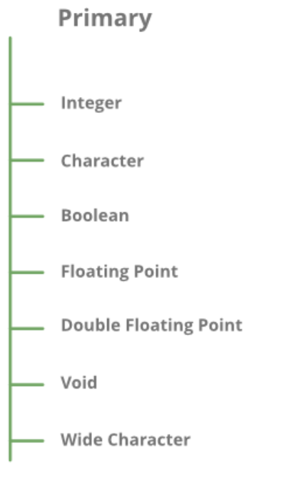
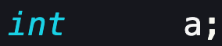
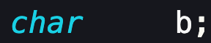
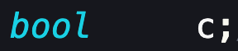
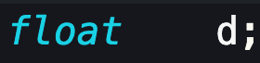
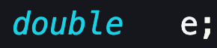
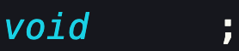
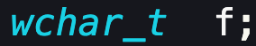
Primitive DataTypes

Slide 11
Data has a special representation
Computers can only understand binary, i.e. ‘1’ and ‘0’
These values can be read as High or Low, True or False and often refers to logic levels.
The code that you write is compiled straight down to binary – Hopefully you watched that video from the first presentation
A group of 8 bits is called a byte
Byte
10101010
(Least Significant) bit
(Most Significant)
bit
bit

Slide 12
Data has a special representation
A byte is 8 bits, which is 2⁸ = 256, which means the highest number we can represent is 256!
That’s not really useful, so how do computers work with higher numbers or even decimals?
Fortunately though the ASCII table (binary encoding for letters, numbers) only goes up to 256
But that’s only the English alphabet, so, we’re in the same issue again.

Slide 13
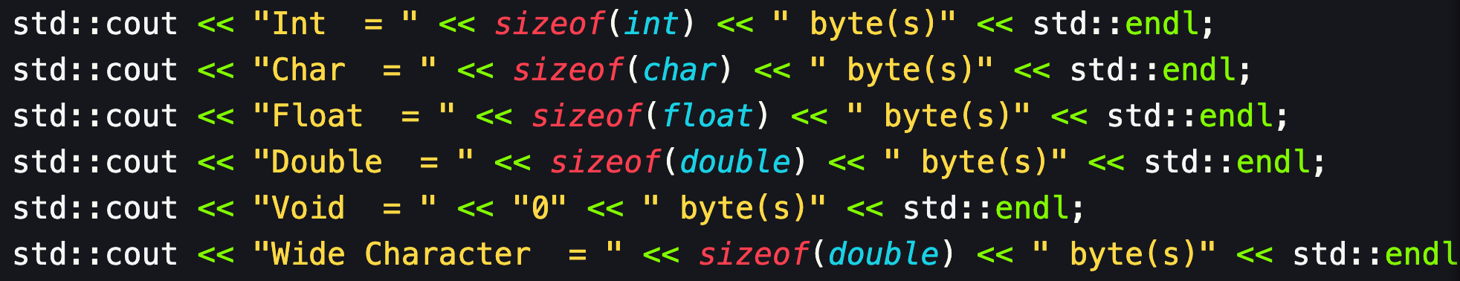
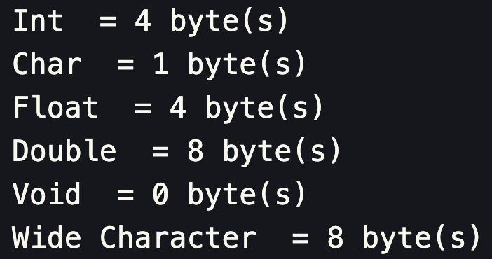
Primitive DataTypes: Sizes

Slide 14
Modifiers
Manipulate datatypes’ data representation or storage capacity to contain more, less or specific types of numbers.

Slide 15
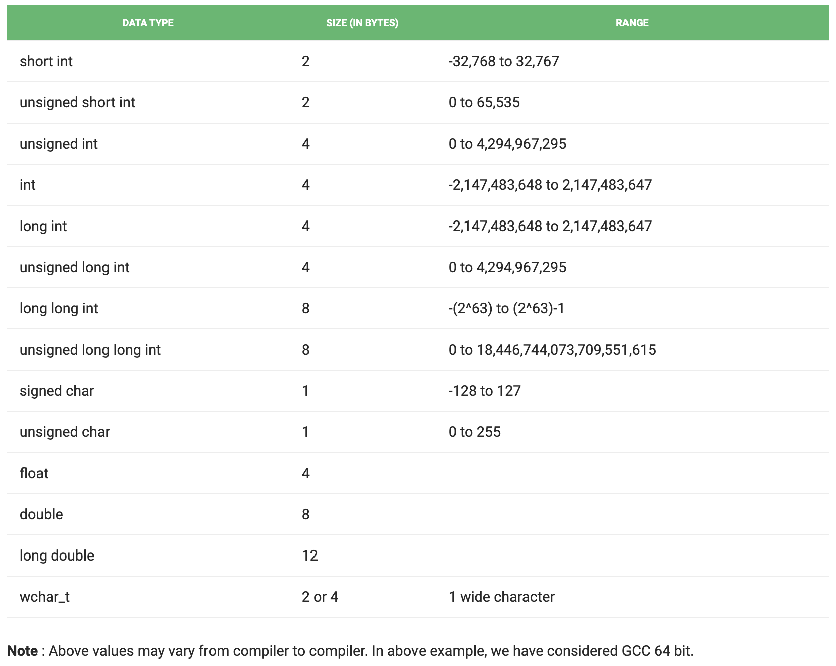

Slide 16
Variables

Slide 17
Variables
A referable name given to a memory location
Allows operators to locate and modify the information at that location.

Slide 18
There are three types in C++:
Local:
-> Variable(s) declared in a block of code
Instance:
-> Variable(s) defined outside a function or class
Static:
-> Variable(s) declared and located similarly to an instance one. However, it includes the keyword “static” and is stored differently.

Slide 19
Recap:
Operators
DataTypes
Variables

